Slide 1
HARTFORD DATA INTEGRATION PROJECT
HARTFORD, CT
ANGELIQUE CROASDALE & SHERYL HOROWITZ

Slide 2
Key Partners
City of Hartford Ryan White and HOPWA recipient Offices
AIDS CT,
Connecticut Children’s Specialty Group,
Community Health Center Inc
Chrysalis Center,
Community Health Services Inc
Charter Oak Health Center,
Community Renewal Team,
Hartford Gay and Lesbian Health Collective,
Hands on Hartford,
Human Resource Agency of New Britain,
Latinos Community Services,
Mercy Housing and Shelter,
Rockville Hospital,
Hospital of Central Connecticut,
Hartford Hospital
Saint Francis Hospital,
St Phillips House,
University of Connecticut Health Center
Zezzo House

Slide 3
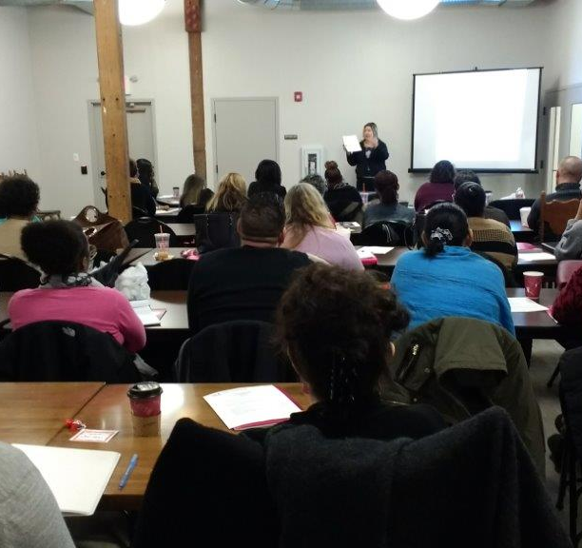
Major Accomplishment
Software User Agreements
Joint Site Visits
DIG Steering Meeting Committee
Recipient Joint

Slide 4
Challenges Experience
Impact of HOPWA Modernization
Issues with conflicting protocols, particularly for programs with braided AIDS/HIV housing funding
Notes:
The HOPWA program is currently undergoing modernization. Most sites in the Hartford TGA are being funded under a formula that has been revised. This process was accompanied by new monitoring guides without a corresponding training for grantees and their sub-recipient. Moreover, the information management system that HOPWA funded programs use (HMIS) is impacted by a governance structure and implementation policies.

Slide 5
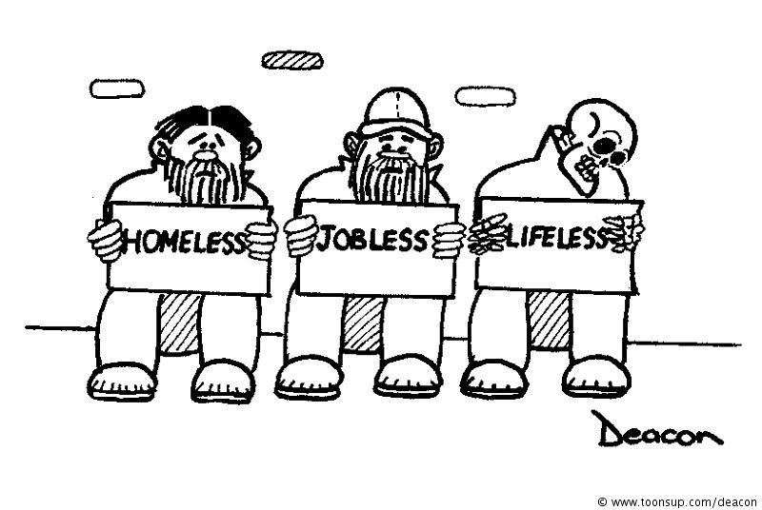
Challenges Cont.
Limited housing assessment tool in the Ryan White data software
CAREWare only has a four point housing instability determination of needs
Notes:
Some sites are in flux and each has different degree of interaction between housing and medical management
sides—housing is about options and choice – housing first is key- everything else follows, while there is more consequence for not following protocols in medical side—has more rigor and less flexibility—there needs to be a dialogue around how to reconcile the two approaches and how to understand optimal intersections and processes

Slide 6
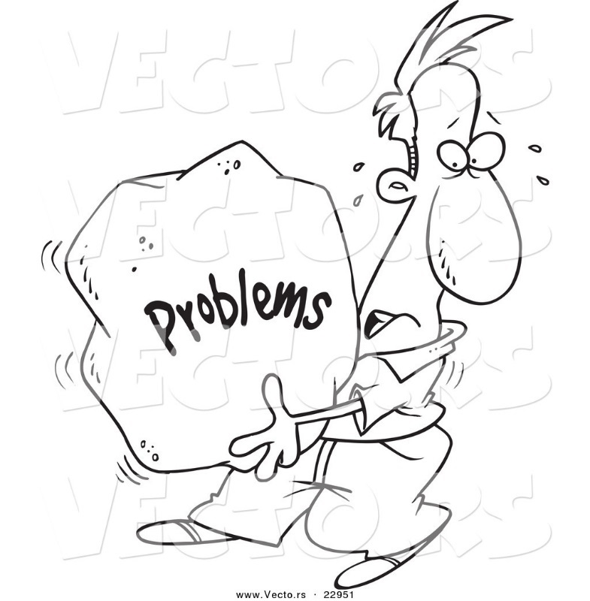
Challenges Cont.
Late realization that the HOPWA data system was not able to incorporation the needed modifications without a lot of structural modifications. Cost issues of sites and funding stream issues.

Slide 7
Six Month Projections
Completing the Bidirectional Interface
Ensuring Contract Language is Clearly Incorporated Within the HOPWA Contracts
Incorporating Security Documentations
Conduct the Joint HOPWA & Ryan White End User Trainings
Assessing the New “Alert” Feature

Slide 8
Sustainability
All Eyes are on Hartford
Partnering Recipients Wants to Adapt this Project Model
Joint Trainings will Continue
Monthly Joint RW/HOPWA
CMTI
Striving to Meet CT Integrate Care & Prevention Plan Goals
Ct is Moving Toward Getting TO Zero (GTZ)

Slide 9
Data Flow Chart
Housing + RW Case
CPH
All RW Providers
HMIS
Data Coordinators
All Providers
All HOPWA
City of Hartford
CAREWare
Nutmeg

