Slide 1
DIG Local Evaluation
Provider Survey
Peer-led sessions
Initial remarks on local sites

Slide 2
Provider Survey
Baseline

Slide 3
Provider Survey Respondents N=30
Role | Responses |  | % Cases
 | N | %
Housing Case Management | 7 | 16.3% | 23.3%
Medical Case Management | 15 | 34.9% | 50.0%
Navigation | 7 | 16.3% | 23.3%
I do not provide direct services | 3 | 7.0% | 10.0%
Other | 11 | 25.6% | 36.7%
Total | 43 | 100.0% | 143.3%
For the analysis:
Respondents were able to choose multiple roles ( total responses = 43. (% cases reflects division by 30 and % responses reflects division by 43)
A category was created for the 2 respondents who labeled themselves as both RWCM and HCM.
Of the 11 who categorized themselves "Other", 7 had already categorized themselves in another category. Therefore only 4 without another designation are counted as "Other"

Slide 4
EDUCATION
37% of providers in the survey have graduate degrees.
Proportionately more Housing vs Medical CM have graduate degrees: (60% vs. 31%)
JOB TENURE AND DIG TRAINING:
Medical CM respondents have longer job tenure but less training hours in DIG than Housing CM
Medical CM respondents are more likely than Housing CM to agree they have enough training on the new system to use it correctly
.

Slide 5
USE OF THE DATA SYSTEM:
Housing CM are more likely than Medical CM to use DIG to access cross-system data*
(* MCM accessing housing info and HCM accessing medical info)

Slide 6
1. Around ¼ of CMs say they are not using the new system
2. MCM are most likely to use it to check health indicators
3. HCM use it for health indicators, and housing information
4. Only 20% of MCM say they use the system to check housing status.
USE OF THE DATA SYSTEM:

Slide 7
Reasons for not using the data system
1. The data system is hard to use
2. I don't need the data system
3. I was not told to use the data system
4. I use my organization's data system
Total responses = 5

Slide 8
What are positive aspects of using the integrated data system? (n=20) | Source
Efficiency
Having real time information | HCM
More efficient communication with other providers | HCM
On-Demand information | MCM
Reduces work for MCM easy access to housing data- | MCM
Speed and efficiency | MCM
Direct access to patient housing status | MCM
Data sharing | MCM
Helps with tracking | Other
Centralization of information | Other
Saves time finding information | Other
Productivity
Additional information to help client navigate through services | Navigator
Provides a check on client's use of services(abuse of system) | Not a provider
Keeps managers informed | Not a provider
Increases CM tools for serving clients | Other
HCM have access to health outcomes | MCM
Reliable and accurate data on client housing and adherence | MCM
Optimism
When its complete we will be able to serve clients better | MCM + HCM
No data available | 4

Slide 9
What are challenging aspects of using the integrated data system? (n=22) | Source
No challenges to report | 5
Lack of data in system | MCM, HCM
Training on use of system | MCM, HCM, Nav
Client buy-in/consents | Non provider
Inefficiency- update alerts , speed of system | Other
Lack of exposure/awareness of system | MCM
Training on Structure of Integration (cross training) | MCM, HCM
User interface inadequate | MCM

Slide 10
Peer led Sessions
9/18-4/19
5 sessions

Slide 11
Participation by role in Peer-led sessions
Twice as many RW CM attend the sessions as Housing CM

Slide 12
Participant Level of experience
Earlier sessions were attended by more experienced participants while more recent sessions are more diverse

Slide 13
1. Irrespective of their role, all participants learned new information at Peer-Led Sessions.
2. Over time, the % of participants stating that most of the material was new decreases, but the attendance at the sessions is staying stable
N= 13 28 19 23 17

Slide 14
1. Around 90% of CM met new contacts at their sessions.
2. Even at more recent sessions. Only 5-6% said they already knew the people at their session.

Slide 15
1. ~ 43% of both RW and Housing CM contacted or were contacted by others as a result of these meetings.
2. Actual contacts by participants seemed to decrease over time

Slide 16
1. Proportionately fewer RW CM are “ready to implement”.
2. Confidence to implement varied depending on the session but correlated with the ratings of the presenter

Slide 17
1. A higher proportion of Housing CM stated that they “very much” have the data to coordinate medical and housing services (68% vs 42%).
2. The percent of respondents stating they did not at all have the data to coordinate medical and housing services increased in the last sessions

Slide 18
On-site local review
(in progress)
Case notes
Key interviews

Slide 19
Objectives:
To look beyond the ability of the new system to collect and distribute new data to how is cross-system data used by providers with their clients.
Following their training and the implementation of the new data system, have staff changed their behaviors and actions with clients.
What is the direct and indirect messaging of leadership about integrating this system into their processes and procedures.

Slide 20
Design
6 sites are selected. Split between medical and housing sites.
Each site selects a sample of clients and associated CM
  Client signed DIG consents OR
  Has needs beyond those assigned to the CM (i.e. Housing and HIV)
Review of case notes from 6 month period before and after DIG
  tracking form – check off present/absent (e.g. referral, meetings, cross-ref
Short interview with Case managers (2) and Agency leader (1) about their understanding and perceptions of the value of this new system.

Slide 21
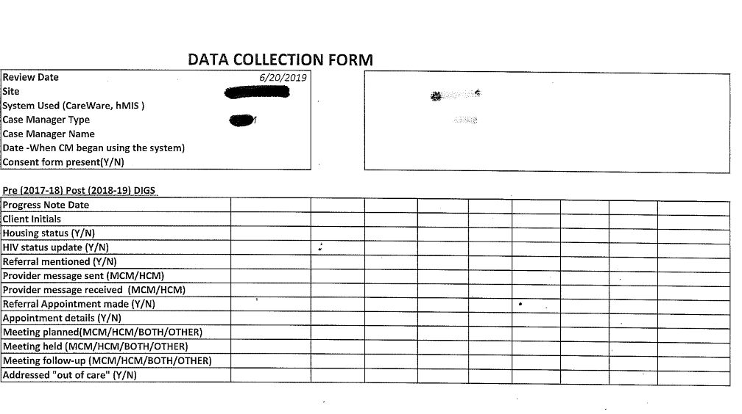
Tracking Form

Slide 22
Initial Observations:
Clients who are using cross-agency services are not easily identified.
  Needed matched lists
Multiple platforms are used on both the medical and housing sides
  The leading platform may not be the most efficient or effective for all functions
  Case Managers feel that their time is not well spent when they are asked to input or duplicate information in multiple systems
  Fully integrated systems would be welcomed.
Case Managers regularly perform functions outside of their roles – holistic care
Extracting the data from these systems is time consuming.
  Fragmentation of data makes it hard to synthesize information
Peer-led meetings have had the most effect on ability to connect clients with services

Slide 23
Next Steps:
Continue to visit sites and follow-up with case managers and leaders

Slide 24
Questions
???????????????????????

