Slide 1
PIT App Training
PIT App Training:
Unsheltered HMIS and Non-HMIS
Sheltered HMIS and Non-HMIS
Link:
https://poe.nutmegit.com/AppCenter2
Help Desk:
help@nutmegit.com
Notes:
Details TBA

Slide 2
PIT App Guides
Program Guides:
ES Check Ins-2022.2023
Hotel.Motel HMIS Participating - Hotel.Motel Service for PIT Count-updated
PSH.RRH Housing Move in date for PIT-2022.2023
Unsheltered HMIS Participating - Current Living Situation Assessment-2022-2023
General Guides:
New PIT App Login Guide-2022.2023
PIT App-login and bed count guide-2022-2023
How to generate your outreach open enrollment client list from HMIS-2022.2023
PIT App - Total Person Count Validation and HMIS Client ID List
Notes:
Details TBA

Slide 3
PIT App Training
PIT App Training:
Unsheltered HMIS and Non-HMIS
Notes:
Details TBA

Slide 4
HMIS Participating Street Outreach
Similar to the count process last year, HMIS participating SO programs will be using the HMIS Current Living Situation Assessment as the trigger to get their data to import into the PIT database.
The Head of Household for each client record to be counted on the night of PIT will need the following:
Open program enrollment
Current Living Situation Assessment dated for the night of the PIT count
A homeless setting selected as the current living situation
You will be able to start working with the people count immediately for this year. This will allow users to actively test their data and clean up their data all the way up to the night of the count.
The PIT App will only see Current Living Situation Assessments that are dated for the previous day. So if, when you check your data you don’t see any records, that may be correct b/c there have not been CLA’s complete for you clients.
What is more important is to make sure you have reviewed the CLA DQ report which shows the client ID’s that have not had a CLA in the past 90 days or longer.
Notes:
Details TBA

Slide 5
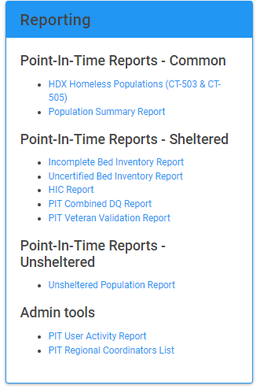
HMIS Participating Street Outreach
Street Outreach enrollments without a Current Living Situation Assessment in the past 90 Days report
Click on the PIT Combined DQ Report Link
Last tab of the excel workbook - ‘No recent CLA’
This report provides a list of client ID’s by program who have not had a recorded assessment in HMIS in the past 90 Days from the day you export the report.
Example, if you run the report today then all the ID’s on that tab have not had a CLA dated from 10/18/2022 back to at least 8/18/2022 and later.
Notes:
Details TBA

Slide 6
Non-HMIS Participating Street Outreach
Similar to the count process last year, Non-HMIS participating SO programs will be able to enter their data directly into the PIT app.
I will need to know the user information
First, Last and Email
Name of SO program
If there is a new SO program that is not currently listed on the PIT App SO program sheet, then I will need the program set up sheet to be completed and submitted.
Non-HMIS Street Outreach can start entering and testing out their data by 10/19/2022. Take time to practice and submit questions if you are unsure of how to populate any of the tables
Notes:
Details TBA

Slide 7
HMIS and Non-HMIS Participating Street Outreach
Unsheltered Population Report is an inventory of both the HMIS and Non-HMIS program data.
This report will populate the people count data for all confirmed Unsheltered programs in the PIT App.
If a program has not confirmed their data then their population data will not display on this report.
Notes:
Details TBA

Slide 8
PIT App Training
End Street Outreach
Notes:
Details TBA

Slide 9
PIT App Training
PIT App Training:
Sheltered HMIS and Non-HMIS
Notes:
Details TBA

Slide 10
HMIS Participating Programs:
ES, SH, TH, PH, RRH
Similar to the count process last year, all HMIS participating programs will have their people count data imported to the PIT database directly from HMIS
The user must first complete and confirm their bed count information and then the PIT count feature will be active.
You will be able to start working with the people count immediately for this year. This will allow users to actively test their data and clean up their data all the way up to the night of the count.
All programs are encouraged to refresh and review their PIT data to make sure the counts are correct and make sense.
Notes:
Details TBA

Slide 11
HMIS Participating Programs:
ES, SH, TH, PH, RRH
The rules that will pull client data into the PIT App are the same for all program types as last year other than ES Hotel/Motel programs - there is a slight change for these programs types.
For ES - the rules are the same as last year:
Open enrollment
ES Check-in dated on the night of PIT - all household members
For SH and TH - just need an open enrollment
For PH/PSH and RRH:
Open enrollment
Move in date dated on or before the night of PIT - Head of Household
For ES Hotel/Motel - New for this year
Open enrollment
Motel/Hotel Costs service dated on the night of PIT - Head of Household
Notes:
Details TBA

Slide 12
Non-Participating Programs:
ES, SH, TH, PH, RRH
If you are part of a non-hmis participating program and you did not manage data for the PIT count last year then I will need the following:
First name, last name and email
Name of program or programs you will need access to
If there is a new housing program that is not currently listed on the PIT App program sheet, then I will need the program set up sheet to be completed and submitted.
Notes:
Details TBA

Slide 13
All Programs
The PIT Combined DQ Report provides data quality tabs to evaluate data completeness for the PIT programs.
Clients Reported Multiple Times – All HMIS
This report will show clients with overlapping enrollments
These clients are being counted for PIT under two different program enrollments – This happens when these enrollments are both open and on the night of PIT they have one or more of the following:
Move In Date
Shelter Check-In
Motel Service
Current Living Situation Assessment
This is not a duplicate client issue b/c these clients have a single HMIS ID. A duplicate client issue would be the same client with 2 or more HMIS ID’s
As PIT data is confirmed in the PIT App this report will begin to populate. The CoC’s should monitor this report and reach out to agencies to determine which enrollment is correct. Nutmeg can assist with the data clean up as needed.
Duplicate Clients – All HMIS
This report will show clients who are duplicates in HMIS and being counted in more than one program on the night of PIT
This is different than the Multiple Enrollment Issue above b/c these are identical clients but with different HMIS client ID’s. Where as above, they are a client with only one ID but open enrollments whose start dates over lap.
As PIT data is confirmed in the PIT App, this report will begin to populate when it finds duplicate client ID’s Nutmeg will review this report and merge ID’s where necessary. Nutmeg will reach to any agency if there are any questions.
Notes:
Details TBA

Slide 14
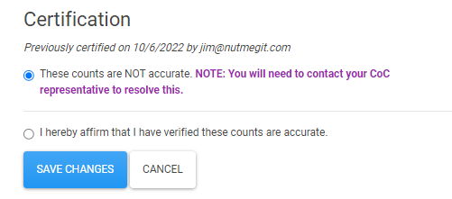
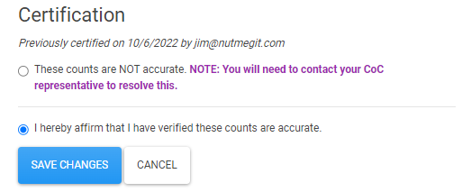
HMIS and Non-HMIS Participating Programs: ES, SH, TH, PH, RRH
The Incomplete Bed Inventory Report will show all programs who have no certifications, meaning they have not looked at their data yet.
Once the program has updated the status at the bottom of the inventory screen then they will come off this report
Notes:
Details TBA

Slide 15
HMIS and Non-HMIS Participating Programs: ES, SH, TH, PH, RRH
The Uncertified Bed Inventory Report will show all programs that have been marked as ‘NOT Accurate’
This report would show those programs that do not agree with the bed information and should be actively working with their CoC to update the bed count numbers.
Once the program has updated the status to ‘affirm’ then they will come off the list
Notes:
Details TBA

Slide 16
HMIS and Non-HMIS Participating Programs: ES, SH, TH, PH, RRH
The HIC report is the full report of all bed and people count data reported on the night of the count
This report is used by the CoC’s for their HDX Inventory submissions.
This report can also be used to evaluate the HDX Homeless Population Data for accuracy
Notes:
Details TBA

Slide 17
All Programs
The PIT Combined DQ Report provides data quality tabs to evaluate data completeness for the PIT programs.
Overutilization - Total Persons
Overutilization – Units
Underutilization - Total Pers.
Underutilization – Units
Demographic Mismatches
No PIT Count
No Bed Inventory
More Enrolled Than Counted
Clients Reported Multiple Times
Duplicate Clients
No recent CLA
Notes:
Details TBA

Slide 18
HMIS ES and SO Veteran Report
The Veteran Validation Report is a report for the VA to be used to help confirm VA records being counted in ES and HO on the night of PIT
The VA can review this report and see the agency, program, program type and HMIS ID so they can check the client information out of HMIS against their records to confirm if the Veteran Status in HMIS is correct.
Notes:
Details TBA

