Slide 1

ACT CAF/HAF
2024 – 2025 Presentation
1
Notes:
1

Slide 2
2024-25 Presentation Agenda
Operating Principles
General Eligibility Requirements
Client Intake Requirements
Overview of Services
Client Assistance Funds (CAF)
Housing Assistance Funds (HAF)
Determination Process
Contact Information
2

Slide 3
Operating Principles
1990 Ryan White CARE Act
Ryan White Funding is intended to address the emergency needs of people living with HIV, and must be the funding of last resort. This is not an entitlement. It is not meant for ongoing financial issues.
Written documentation concerning the reason for requests is required per HRSA and the City of Hartford.
3
Notes:
3

Slide 4
Medical Case Manager Partnership
MCM are crucial to the success of the CAF/HAF Program. It is important for MCM to maintain ongoing communication with ACT, as well as other Ryan White agencies/healthcare providers.
  MCM should provide budgeting assistance to ensure client self-sufficiency and success.
  MCM role is to help clients access suitable entitlement programs, subsidized and affordable housing programs, utility assistance, and food assistance.
  Complete and accurate submission of client documentation will allow ACT to administer assistance in a timely manner. The cover sheet/checklist serves as a tool to ensure completeness of applications.
4
Notes:
Budgeting: for example, if a client is on the subsidy and they are approaching the end of their contract, it is important to let the client know so that they can adjust their monthly budget.
4

Slide 5
RW Funding Streams & Client Eligibility
RW Part A/Hartford TGA – Client’s must be a resident(s) of the Greater Hartford Transitional Grant Area (TGA) – Hartford, Middlesex and Tolland Counties.
  Grant Cycle: March 2024 – Feb 2025
RW Part B – Funding prioritizes Tolland Counties, but serves client’s statewide.
  Grant Cycle: April 2024 – March 2025
In cases where the client is affected rather than infected, the service(s) must be intended to provide direct benefit for the infected individual (s).
5

Slide 6
Client Eligibility & Intake Requirements
Release of Information to ACT/ RW Network updated every 24 months
Ryan White Consent Form updated every 24 months
ACT CAREWare Consent form updated every 24 months
ACT Bill of Rights is for the duration of client services (one-time signature)
Client Lab Report- CD4 Count & Viral Load updated every 12 months
Ryan White Eligibility Form updated every 12 months
Income Verification (SSI Letter, Work Income/paystubs, Zero Income Affidavit) updated every 12 months
Client Demographics
If the documentation is in CW – you only need to fax the request forms. We highly recommend uploading documentation into the appropriate data system.
Requests require INTERNAL CW referrals.
6

Slide 7
CAREWARE Navigation &
Client Files
List client as “Eligible” under appropriate funding stream( i.e. RWA, RWB, and/or HOPWA)
Ensure client address, phone number, and all other personal info is up to date
Ensure the client’s Medical Case Manager contact information is up-to-date.
Grant Clinical Sharing Requests so that CAF/HAF can view client’s most recent Lab reports
Submit INTERNAL REFERRAL for requested services

Slide 8
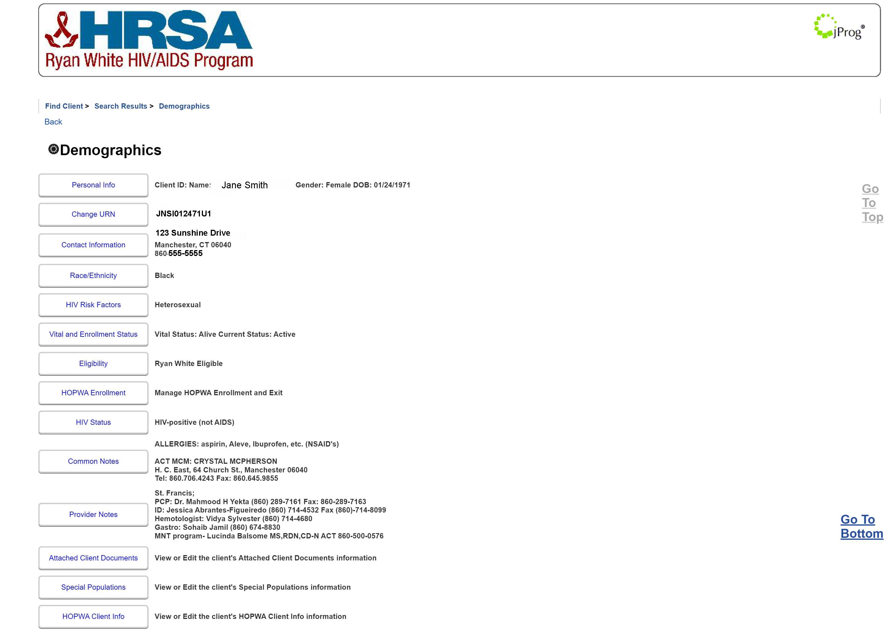
CAREWare: Client Demographic Example

Slide 9
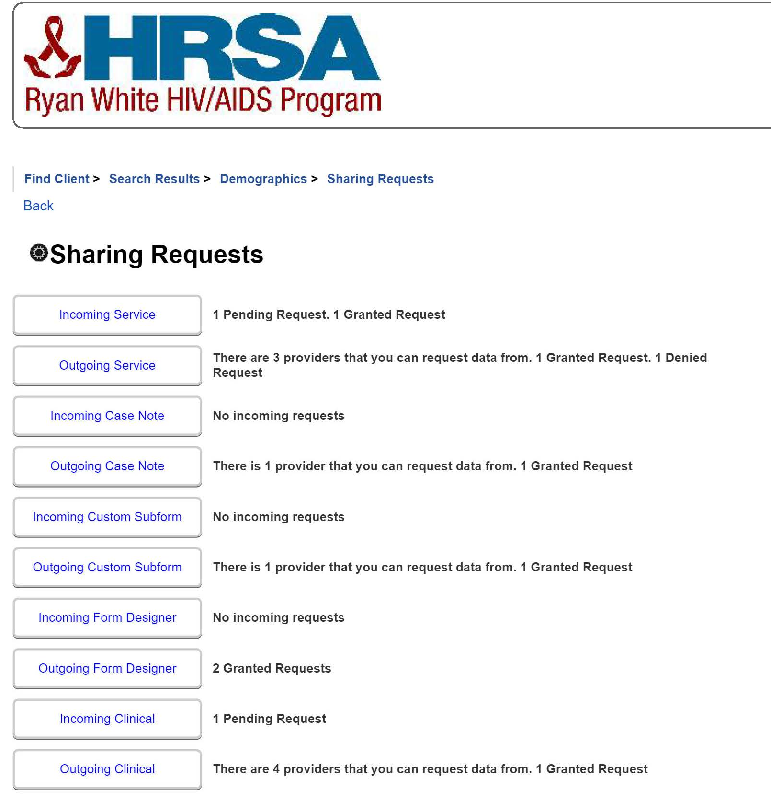

Slide 10


Overview of Services
Client Assistance Funds (CAF)
Over the counter medications (EFA Meds)
EFA Utility Assistance
Food Voucher Assistance
Health Insurance Premiums & Copays after insurance
Medical Transportation:
  Bus passes
  Coordinated Uber
  Uber Vouchers
  Gas Card Assistance
Housing Assistance Funds (HAF)
First month’s rent
Arrearage (up to two months)
One Time Payment
Ongoing subsidy ($600 month for up to two years)
Emergency Housing: 14 might stay at Carrier Motor Lodge or Little Village Motel
Notes:
10
Durable medical equipment: wheelchairs, oxygen tents, crutches

Slide 11
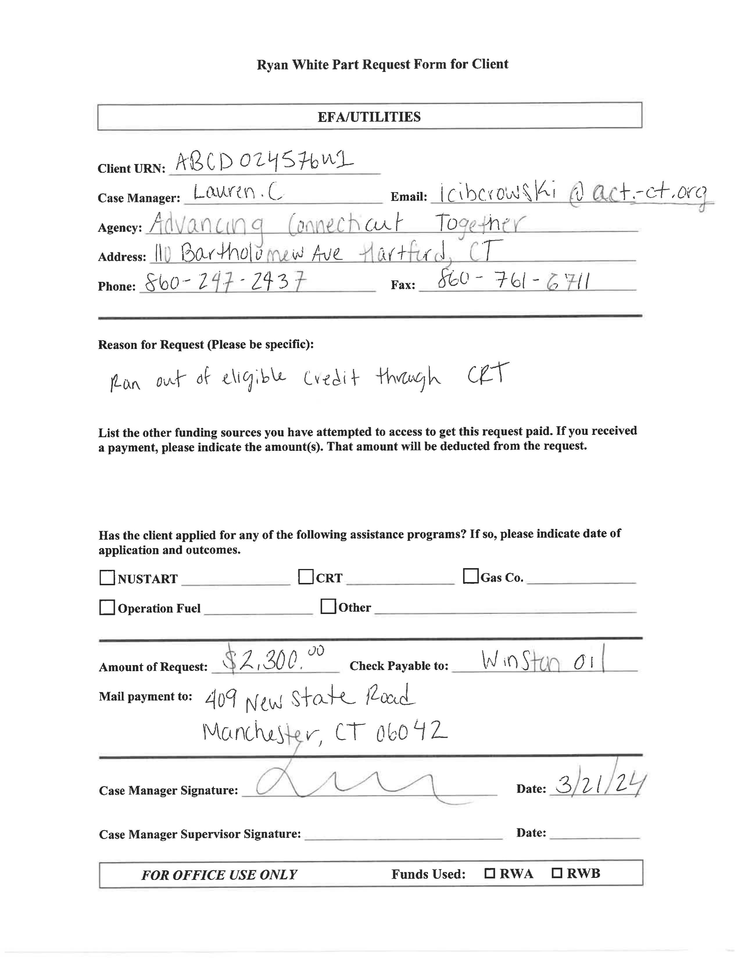
What is missing from this requests?

Slide 12
Application Errors, Missing Info & Docs
Errors on the Request Form
Hand-written
Missing Supervisor Signature
Reason for Request does not justify emergency need for assistance.
‘Other Funding Sources” client attempted to access left blank
Outcomes of other assistance programs left blank
Request exceeds the client cap of $1,000.00.
  Client needs to apply to outside agency or set-up a payment plan in order to be eligible for RW assistance.
Missing Back-Up Documents
Billing Statement from Utility Company
W9 for Utility Company

Slide 13
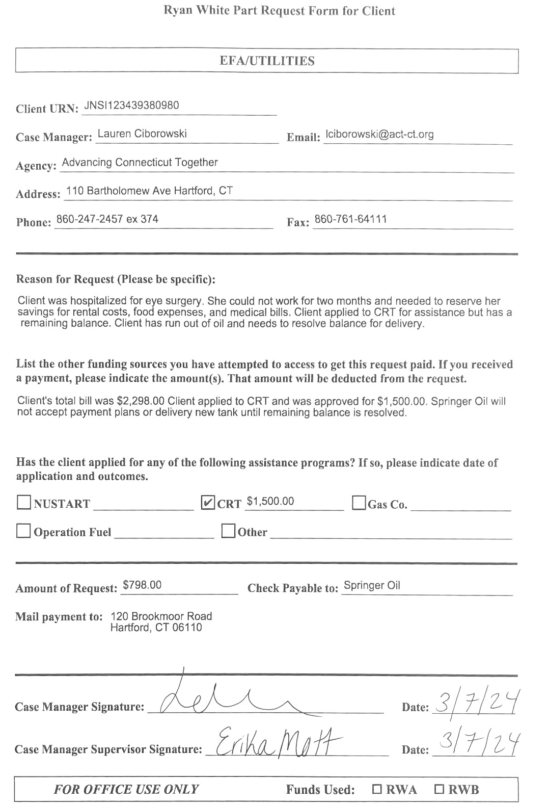
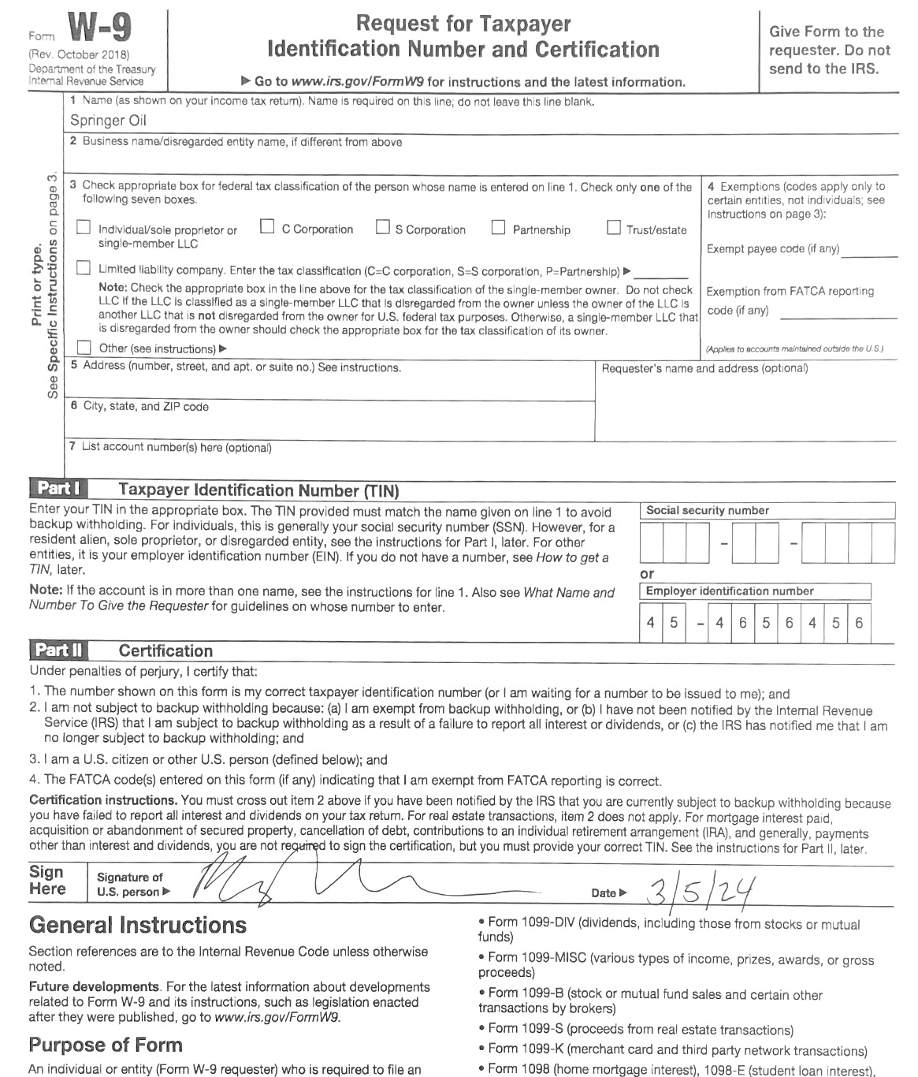
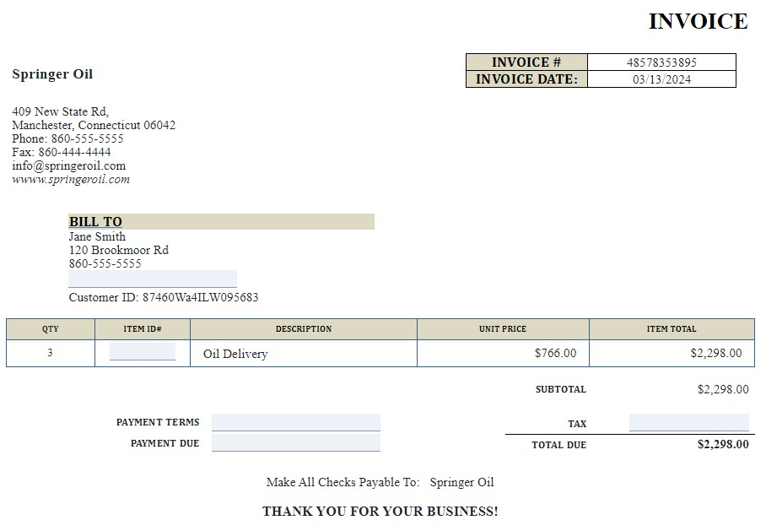

Slide 14
WHAT’S NEW FOR 2024-25?
Example Sheets & Resource Pages included in each application packet!
W9 Request Letter for private healthcare providers, utility companies, Landlords, etc.

Slide 15
Health Insurance Premium and Cost Sharing
For the 2024-25 fiscal year, only RWA Clients are eligible for HIP
Does cover health insurance premiums, as well as Co-pays for medication and medical bills
Does not cover Viagra, other erectile dysfunction medications, durable medical equipment or smoking cessation medications.
Charges incurred OUTSIDE of the contract period may not be covered ( healthcare services must be provided between March 2024- Feb 2025 to be eligible)
Detailed invoices must indicate date of service, type of service, what Insur adjustments were, and the remaining client balance.
Cap of $1,200.00
15
Notes:
This may include co-pays, new prescriptions, refills of medications, vitamins, supplements, durable medical equipment, supplies (such as ostomy bags, insulin syringes, wound dressings, etc.) or over the counter medications prescribed by a physician.
15

Slide 16
EFA Medications
Includes over the counter meds, not covered by insurance.
For the 2024-25 fiscal year, RWA Clients are eligible for EFA Medications
Does not include durable medical equipment
Charges or medications OUTSIDE of the contract period may not be covered.
Cap of $200.00
16
Notes:
16

Slide 17

EFA Utility Assistance
Covers electricity, heating oil, gas payments, & water bills
Does not cover Internet/Cable TV bills
For clients who have past due notices greatly exceeding the cap, CAF/HAF is unable to provide assistance unless a separate agency covers remaining portion of billing statement.
Client’s may apply for the Eversource NUSTART Program, in which case CAF/HAF will pay their Good Faith Payment
Cap of $1,000.00
17
Notes:
Not available for ongoing utility bills.
17

Slide 18

Food Voucher Program
Food Vouchers are intended to be an emergency assistance program for income strapped clients.
After approval is granted, vouchers are processed by finance. The approval letter does not mean that vouchers are ready for pick-up. MCM will receive an email from ACT letting them know that Food Vouchers ready. MCM should email CAF/HAF to coordinate a day/time to pick up available vouchers.
Food Vouchers will not be mailed.
Please apply for Food Vouchers in increments of $40.00
Cap of $200.00
18
Notes:
Not available for ongoing utility bills.
18

Slide 19

Transportation
Bus Passes
Bus passes include 10 ride bus passes (up to 4 at a time/per month) and 31 day bus passes
Transportation Ride Chart must clearly list the locations/address that the client intends to utilize the bus passes. Ride chart must also include the number/frequency of appointments
Clients can either receive transportation assistance through ACT or LCS.
After approval is granted, bus passes are processed by finance. The approval letter does not mean that a case manager can come pick them up. MCM will receive an email from ACT letting them know that Food Vouchers ready. MCM should email CAF/HAF to coordinate a day/time to pick up available vouchers.
19

Slide 20
Transportation Continued
Uber Vouchers
Uber Vouchers are provided in increments $50.00 gift cards. Clients can apply for 2 vouchers per month.
The ride chart with locations and estimated dates of travel are required
Clients must have a working mobile devise to coordinate their trips
Coordinated Uber Health
An ROI to Uber Health is required
Client must have a working mobile devise to coordinate their trips
CAF/HAF requires at least three days notice prior to day of appointment. Last minute requests may not be approved.
20

Slide 21
Transportation Continued
Gas Card Assistance
Gas Card Vouchers are provided in increments $30.00 Shell Station gift cards. Clients can apply for 2 vouchers per fiscal year.
Transportation Ride Chart must clearly list the locations/address that the client intends to utilize the bus passes. Ride chart must also include the number/frequency of appointments
Cap of $60.00
21

Slide 22
Housing Assistance Funds (HAF)
Assessing Housing Stability –Simply having a place to live may not be stable housing
Indications of unstable housing:
  No lease in client’s name
  No income – even with Section 8, there are other life expenses (transportation, utilities, laundry, food, toiletries).
  Living with family or friends.
  Recent loss of a rent subsidy/income.
  A significant increase in rent per month.
22

Slide 23
Outline of HAF Services
First month’s rent. (Documentation of paid Security Deposit is required)
One-time assistance
Arrearage: Up to two months back rent
Emergency Housing: 14 night stay at Carrier Motor Lodge or Little Village Motels
Ongoing Rental Assistance: $600.00 a month for up to two years
    Updated Rent Verification form is required every six months, Intake files must be up-to-date and within current year. Failure to submit Intake forms and RV will result in discontinuation of assistance
    MCM must provide documentation that the tenant is current with their rent. If a client accrues back rent, they will then be removed from the subsidy
    If a client has an increase/decrease in income & falls out of the 40%-80% income to rent ratio, they are no longer eligible for assistance and will be removed from the subsidy.
23
Notes:
23
If a client is CURRENTLY receiving ACT ongoing assistance, missed the re-application process or did not pay that portion of their rent, we will not pay arrearage for those months or for the “ACT” subsidy for those months. If the client is in local subsidized housing or has Section 8, RAP etc.; ACT will look at these applications on a case by case basis.

Slide 24
Eligibility Criteria
  Clients must fall between the 40% - 80% Income to Rent Ratio: Gross income is calculated for client’s on entitlements, while net income is calculated for clients receiving work income
  Should the client fall outside the ratio due to sudden illness or temporarily loss of employment, documentation must be provided by health care provider/employer for verification in order to remain active on the subsidy.
  Clients must apply for other housing assistance programs, as ACT’s RW program is a payer of last resort. Other funding sources are to be document on the Use of Funds Form.
  CMs must provide a subsequent housing plan/long-term strategy
24
Notes:
24

Slide 25
How to Calculate Monthly Income
How to Calculate Income to Rent Ratio
Example: Rent: $750 / Monthly income: $1,100 x 100 = 68%
Calculating income using weekly paychecks | Calculate income using bi-weekly paychecks.
-Add together 4 most recent paystubs | -Add together 2 most recent
-Divide by 4 to find average weekly amount | -Divide by 2 to find average bi-weekly amount
-Multiply by 52 (weeks/pay periods) -Divide by 12 (months) | -Multiply by 26 (pay periods), -----Divide by 12 (months)
Result is monthly income | Result is monthly income
25
Notes:
25

Slide 26
Emergency Housing
  Includes 14 night stay at Carrier Motor Lodge or Little Village Motel. 7 day extensions are considered on a case-by-case basis.
  Should MCM request an extension, CAF/HAF requires at least 3 days prior notice. Detailed emails/requests must be submitted for extensions, outlining the client’s subsequent housing plan & progress made while in shelter
  Client and MCM must call 211 for a referral and obtain a CAN appointment date prior to approval and indicate CAN date on the Use of Funds form.
  An ROI from the Carrier Motor Lodge/Little Village Motel must be signed by the client and submitted with the Emergency Housing Request prior to approval.
  Emergency Housing Agreements must be signed by the client.
    Client’s are not allowed to bring guests or pets into their hotel.
    Clients must refrain from alcohol & drug use
    Other requirements are outlined within the agreement. Failure to comply with the Emergency Housing Agreement will result in immediate check out/loss of assistance
26
Notes:
26

Slide 27
HAF Payments
Checks are made out & mailed directly to the landlord/vendor.
The memo section of each check will contain the name of the tenant, and the address for which rent is intended.
Subsidies are mailed out within the first 10 days of the month
All other HAF checks are processed and mailed by finance within 10 business days
27

Slide 28
Determination Process
Submit requests to ACT’s secure fax 860.761.6711 – email is NOT secure.
ACT’s CAFHAF Coordinator has up to 10 business days to process the requests.
Pending – If documentation from requests are missing, a pending letter will be sent to MCM detailing what is needed. MCM have 10 business days to submit requested paperwork.
It is the responsibility of the applying MCM to follow up and complete a pending application within the ten business days. Failure to do so will result in a denial.
Denied – Denials are sent out to applying MCM and their supervisor. In some instances, the client may be able to reapply at any time.
Approved – Approval letters are emailed to MC within five business days. Payments are processed by finance and sent within ten business days.
Medication reimbursement – Medication/Pharmacy Authorizations are reviewed and prioritized by CAFH/HAF. The pharmacy is informed by fax of denial, pending or approval. A pending letter will be emailed to MC if placed in pending.
28
Notes:
28

Slide 29
Contact Information
CAF/HAF Fax: 860.761.6711 (where applications should be submitted)
Email Corresponded: cafhaf@act-ct.org
Lauren Ciborowski, CAFHAF Coordinator: 860.247.2437 x 379
29

Slide 30
Questions?
30

